Slide 1
Statistical Joe’s Pond

Slide 2
Ice Thickness: Questions and Answers
Problem: No sufficient data exists for ice thickness anywhere near Joe’s Pond.
How can we approximate ice thickness using other means?
What causes changes in ice thickness?
How thick does the ice on Joe’s Pond get over the winter? How quickly does it melt?
Our first thought: how does climate change affect ice out dates?
Fortunately, global climate change data is readily available through NASA.
Our second thought: how does the local weather affect ice out dates?
Fortunately, this data is also available.

Slide 3
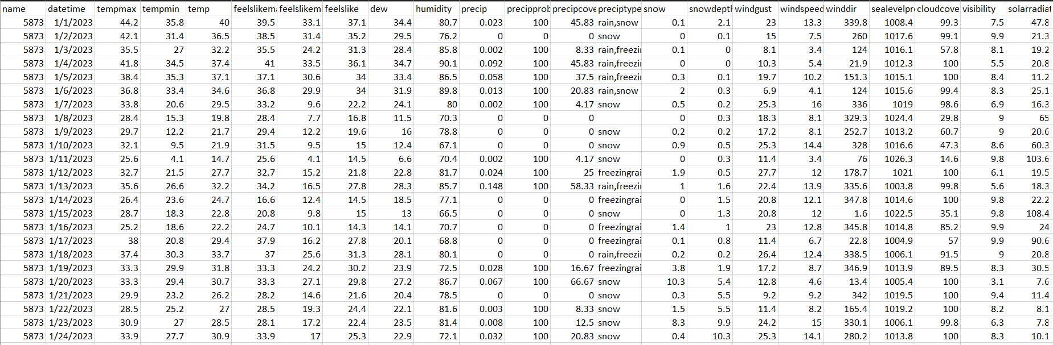
Getting Weather Data
Historical weather data for zip code 05873, for Jan 1 - Mar 31 (the coldest months of the year) of every year since 1988.
Luckily, Visual Crossing provides this data:

Slide 4
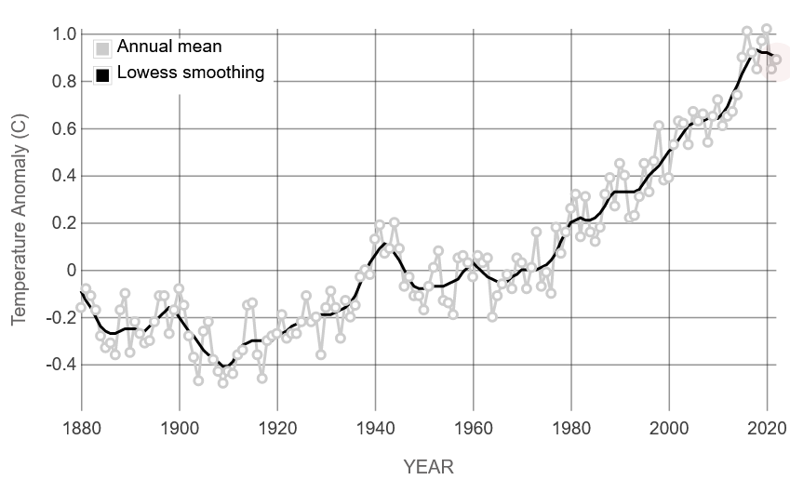
What might contribute to pond freezing/thawing?
How do we measure this numerically in our data?
Impact of climate change
Was this a warm winter?
Did the sun get a chance to thaw the ice?
NASA’s climate change index
Average daily high/low temps
Number of days above freezing
Average precipitation
Average visibility

Slide 5
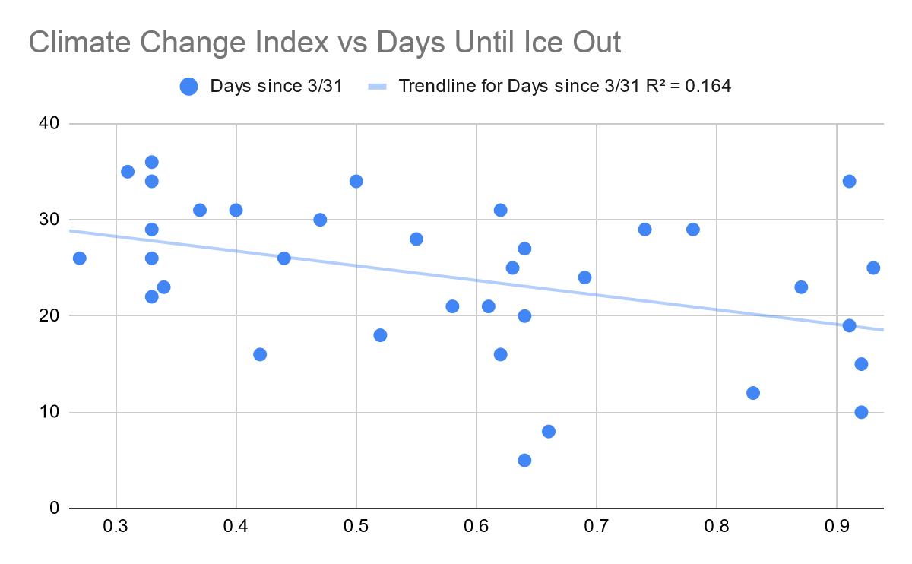
Testing our hypotheses
Climate change
Weak correlation with ice out date
Why? While climate change does affect ice out dates overall, it alone isn’t enough to account for other factors that make weather unpredictable year-to-year.
Precipitation
Weak correlation with ice out date
Why? We’re not sure. Whatever the case, it seems that the amount of snow we get each year is not a good indicator of how thick ice levels are.
Visibility
Medium correlation – perhaps fog can block high-energy light rays from reaching the ice. Low-visibility days might also be more likely to have lower average temperatures.
Average temperature
Our strongest correlation, for fairly intuitive reasons. We tested average daily high temperature for both the month leading up to Joe’s Pond (March), as well as for the first three months of the year

Slide 6
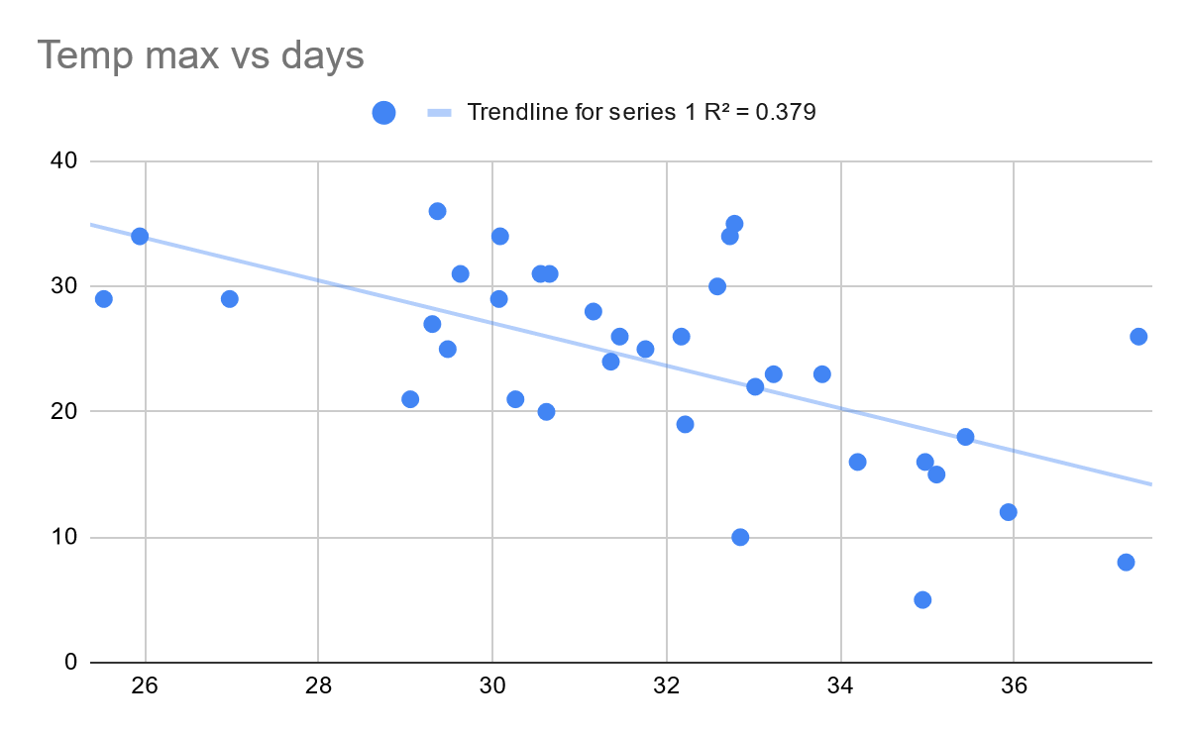
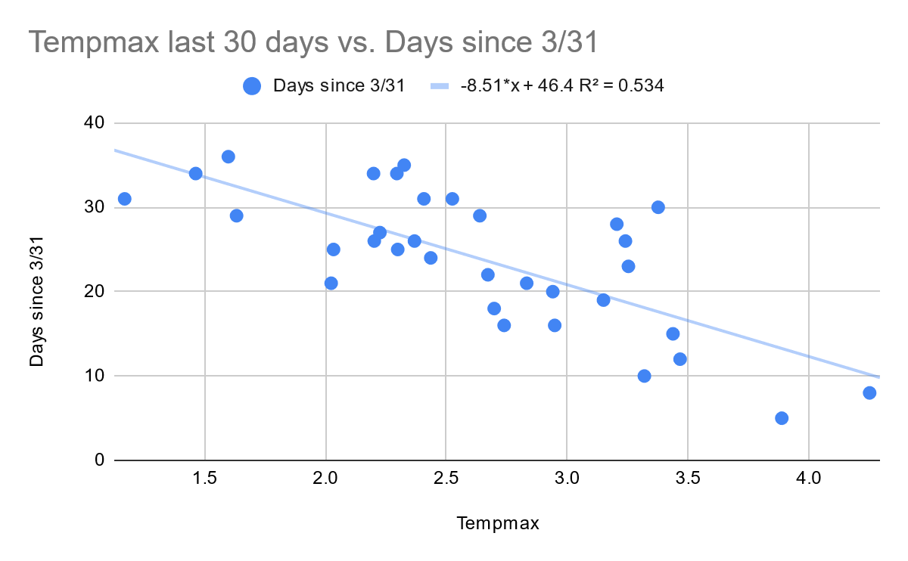
Features
Scatterplot Approx of Model
Prediction Date
Average tempmax over Jan, Feb, & Mar
April 17 @ ~1 AM
Tempmax, visibility, & feelslikemax over month of March alone
April 23 @ ~7 AM
Actual: April 17@10:18 PM
Our closest guess: April 17@4:18 PM

